Slide 1
Azure AI Speech Integration with Optimizely CMS
Anil Patel
Platinum Optimizely MVP / Optimizely SME
& Lead Optimizely Developer
11th July 2024

Slide 2
Agenda
Azure AI Speech Overview
Azure AI Speech Integration in CMS
Text To Speech
Speech To Text
Speech Translations

Slide 3
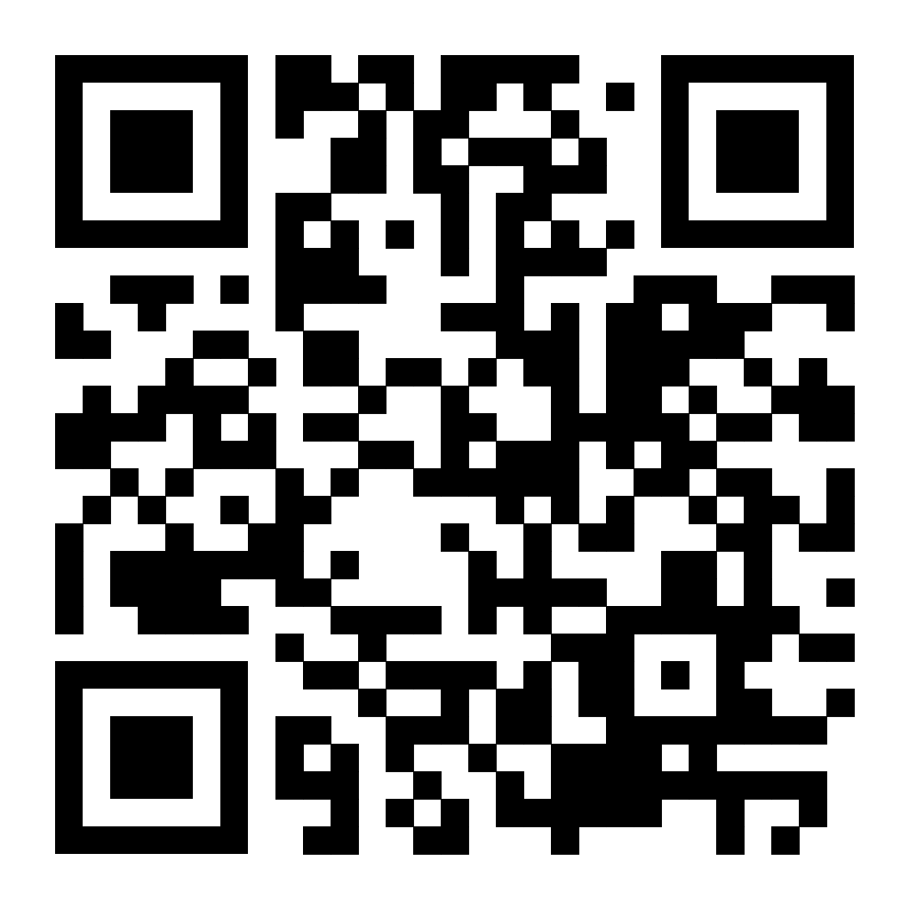
Azure AI Speech Overview
The Azure AI Speech service consists of a set of features and services from Microsoft Azure. Below are just a selection of the main features provided by this service
Text-to-Speech
Speech-to-Text
Speech Translation
Notes:
The Azure AI Speech service consists of a set of features and services from Microsoft Azure.
It is designed to help users add powerful speech capabilities to their applications. It leverages advanced machine learning models to provide a variety of speech-related functionalities.
Below are the key features provided by this service:
Text To Speech:
Speech To Text
Speech Translations
These features are what I will be covering in more detail within this presentation.
If you want to find out more information about the Azure AI Speech Service and what it does, there is a QR code for you to scan which is shown on this slide.

Slide 4
Text-to-Speech
The Text To Speech feature consists of synthesising natural sounding speech from text. The feature is also known as speech synthesis.
Benefits
Accessibility and Inclusivity
Improved Content Accessibility Compliance
Search Engine Benefits
Notes:
Text To Speech:
The Text to Speech feature consists of synthesising natural sounding speech from text.
The feature is also known as speech synthesis.
It also includes neural text-to-speech (Neural TTS) for highly realistic and expressive speech synthesis with a wide variety of voices and languages available for users to use.
Benefits:
Accessibility and Inclusivity
TTS provides essential access to digital content for website users who are blind.
It can also help people with other learning disabilities as well as dyslexia which can improve comprehension and retention.
Older adults with declining vision can also benefit from TTS, making content consumption easier.
Improved Content Accessibility Compliance
Implementing TTS can help websites comply with Web Content Accessibility Guidelines (WCAG) regulations.
Search Engine Benefits
Audio content can increase the time users spend on a page, potentially improving search engine rankings.
I will demonstrate how this feature can be used within Optimizely CMS. When a user publishes text content, the feature will create a speech file based of the published text content in a chosen neural voice which is done by selecting a voice from a dropdown on the Start Page in the CMS.
I will also demonstrate how this can also be done when a user uploads a TxtFile into the CMS.

Slide 5
Speech To Text
The Speech To Text feature consists of converting spoken language in written text. With real-time speech to text, the spoken language is transcribed as speech that can be used to create transcriptions
Benefits
Improved User Experience
Enhanced Accessibility
Notes:
Speech To Text:
The Speech to Text feature consists of converting spoken language in written text. With real-time speech to text, the spoken language is transcribed as speech that can be used to create transcriptions.
Improved User Experience
Users can choose their preferred mode of consuming content, whether reading or listening.
Transcriptions can be edited and refined for clarity and coherence, enhancing the overall quality of content.
Enhanced Accessibility:
Makes content accessible to individuals with hearing impairments who rely on text-based content.
Supports users who are in environments where listening to audio is impractical.
I will demonstrate how this feature can be used within Optimizely CMS. When a user uploads a speech file, the feature will generate a text transcription, based on the spoken language, which will then be stored against the Speech File content type in the CMS.

Slide 6
Speech to text translation
The Speech-to-Text translation feature allows users to take an audio file and translate the spoken language from it into written text in a specified target language.
Benefits
Streamlined Content Creation
Notes:
Speech to text translation
The Speech-to-Text translation feature allows users to take an audio file and translate the spoken language from it into written text in a specified target language. The feature supports multiple languages that enables users to communicate across language barriers. The feature integrates speech recognition, translation, and text-to-speech to provide a seamless translation experience.
Streamlined Content Creation:
Automates the transcription and translation of spoken content, which means Content editors can quickly generate multilingual written content.
I will demonstrate how this feature can be used within Optimizely CMS. When a user uploads a speech file, the feature will generate a translated text transcription, based on the chosen languages in the CMS, which will then be stored against the Speech File content type in the CMS.

Slide 7
What has been Covered
Azure AI Speech Overview
Azure AI Speech Integration in CMS
Text To Speech
Speech To Text
Speech Translations

Slide 8
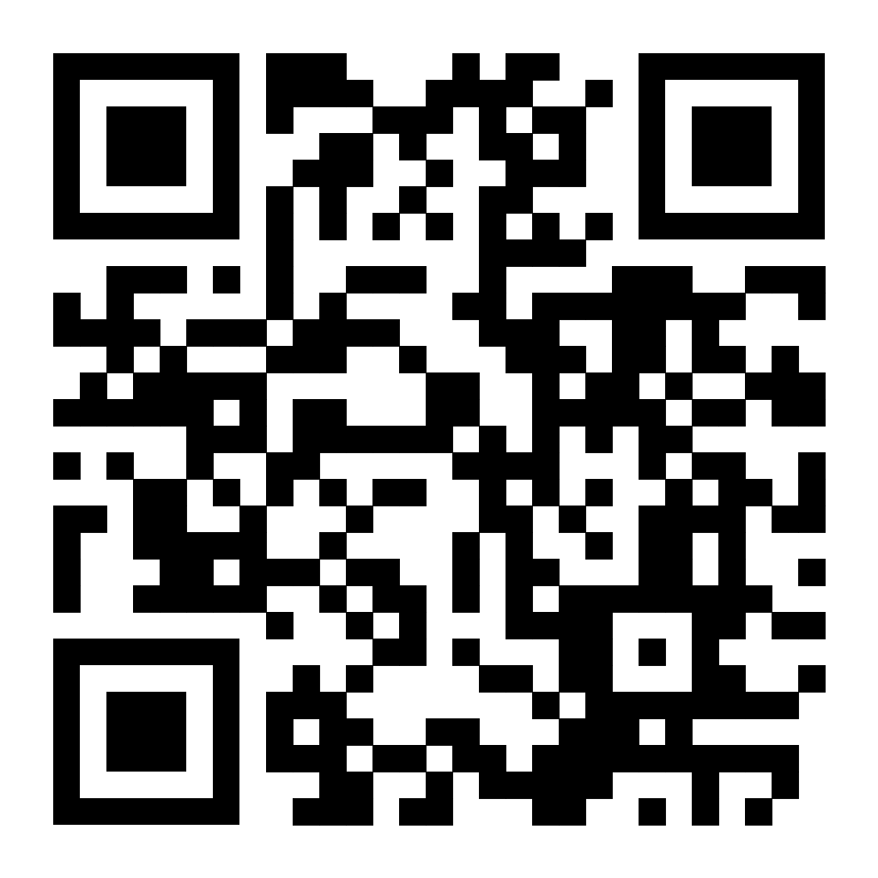
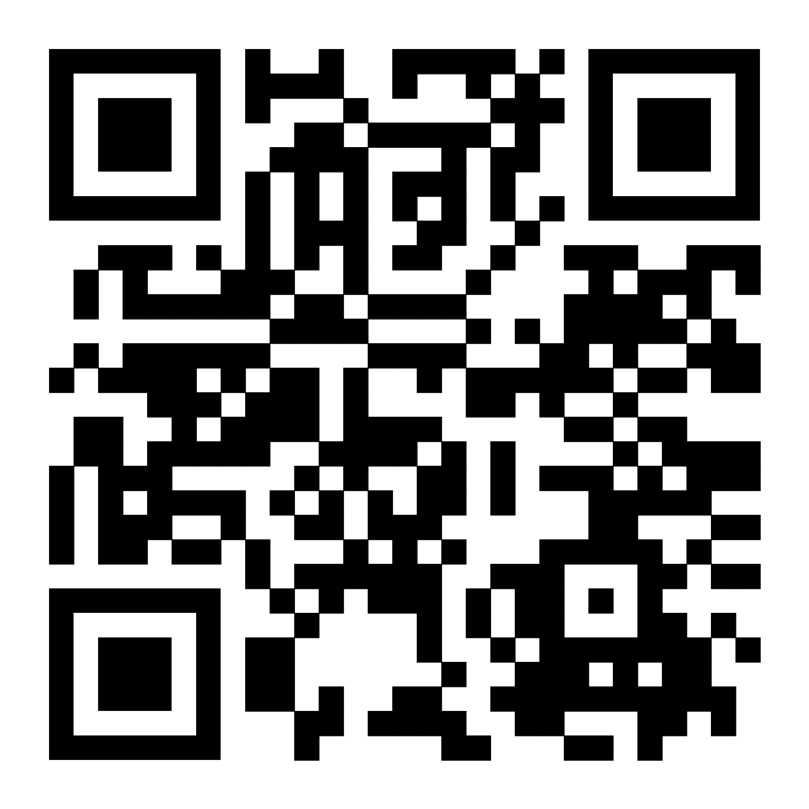
Notes:
Any questions:
If you scan the QR code to the left, it will take you to my LinkedIn profile if you wish to connect with me
If you scan the QR code to the right, it will take you to my website where you can read more about the blogs/articles I create about my research and ongoing work with Optimizely CMS and AI.
Thank you for watching my presentation, I hope you have enjoyed it

