Slide 1
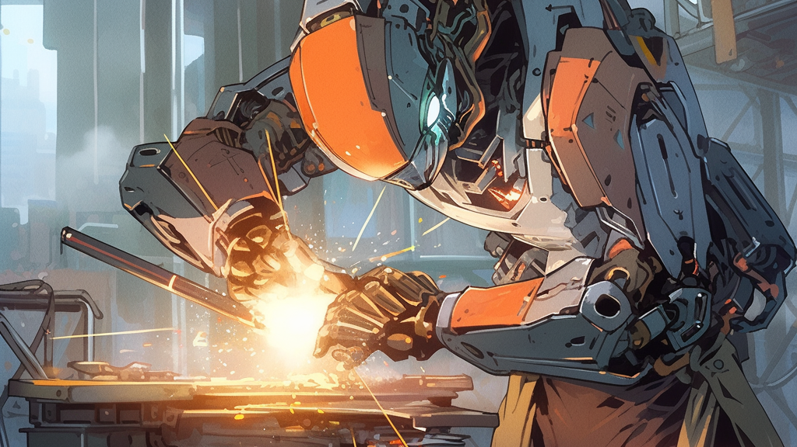
Re-tooling for AI
October 2023
Brian Taylor
Principal Software Engineer
Optimizely

Slide 2
Disclaimer
I am talking as me, not Optimizely.
Nothing you’ll hear is a commitment or a product announcement.

Slide 3
Because…
No one knows the answer yet.
This disruption didn’t exist last time we were together.
I could project confidence, but we’re all running on ten months of context.

Slide 4
We’re all doing the best we can with ten months of experience.

Slide 5
So, seriously
No promises.
We’re technology leaders making guesses together.
This is going to be fun!

Slide 6
My (Secret) Agenda: Convince you that
Optimizely is the ideal partner to discover this future with.
Optimizely is executing today.
There is room at the table for you.
The future is exciting.
We should build that future together.

Slide 7
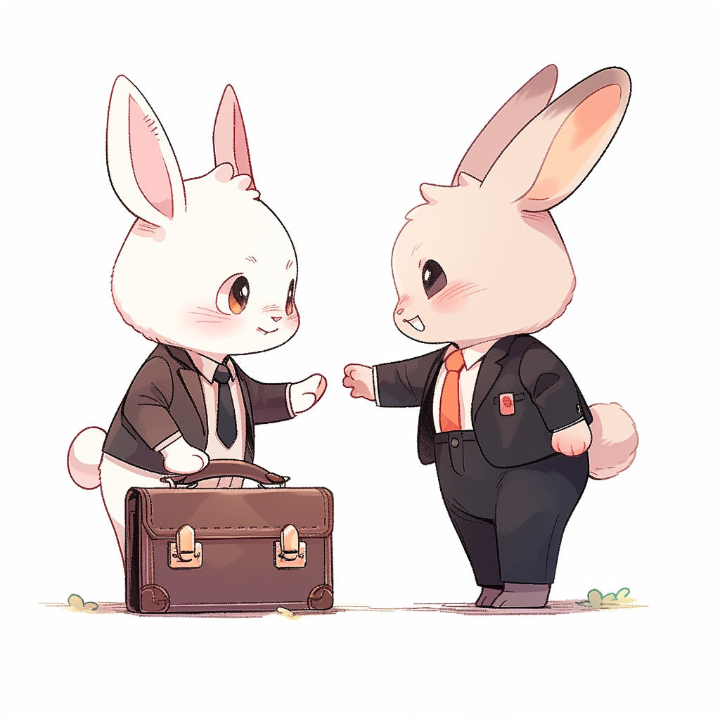
Optimizely is a great friend for the AI future
We have close strategic relationships with the two hardest hitters in the space.
We are actively collaborating to define the future of AI.

Slide 8
Optimizely is a great friend for the AI future
We are a content-centered organization.
Ten months ago, content went from being expensive to finding a path to becoming almost free.
That is going to change our world.
We are taking this seriously.

Slide 9
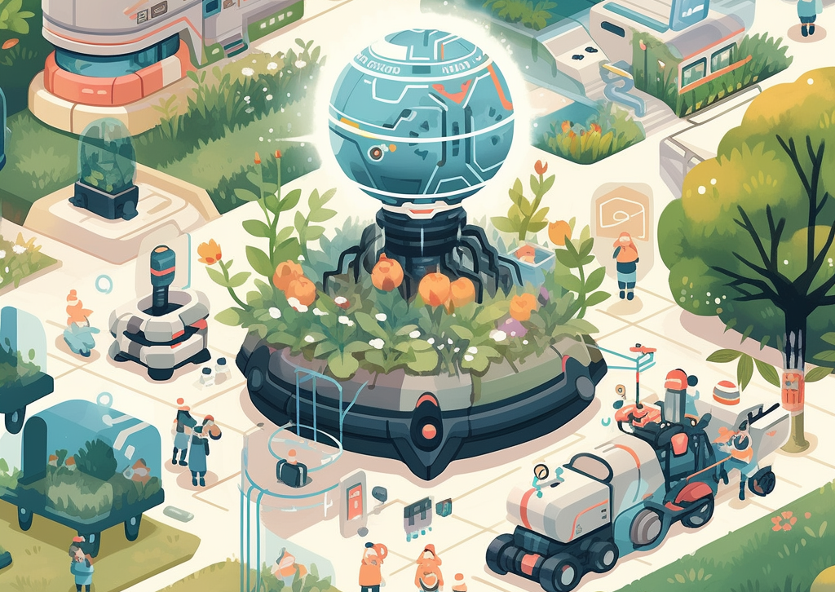
Optimizing is Executing today
Internal AI Platform Mission: Bring critical technologies closer to the engineers applying them.
Abstraction: Create a standard API that delivers all the leading LLMs.
Extension: Extend the base LLMs with higher-level APIs that solve everyday use cases.

Slide 10
Abstraction payoff: Current models allow you to only pick 2
fast
GPT-3.5: fast, good
PaLM 2: fast, cheap
Llama 2: cheap, cheap
GPT 4: good, good
AKA: an engineering trade-space.
good
cheap

Slide 11
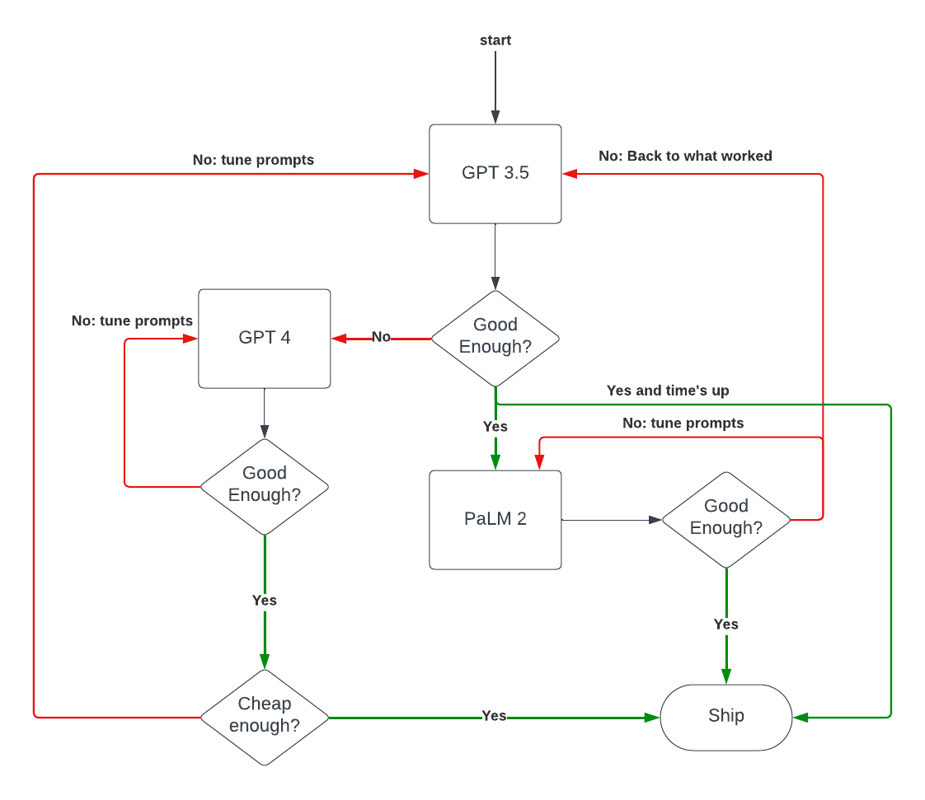
LLM selection in practice (why it’s nice to abstract the choice of LLM)

Slide 12
Sharable APIs: Intermediate Level Features
A general API for significant text summarization.
A general API for question/answering from content graph.
General purpose AI upgraded input widgets.
(Let's connect during the conference if these internal APIs would unlock use cases that you care about.)

Slide 13
Where is this Going?
OpenAI has shown us some of the future it imagines:
Incredible, technology-defining first-party innovations.
Second-class citizen, limited plugin support
This is a ChatGPT Centric vision for the future of operating systems

Slide 14
Let’s set a bigger table
What if our modern view of APIs had evolved along with modern AI?

Slide 15
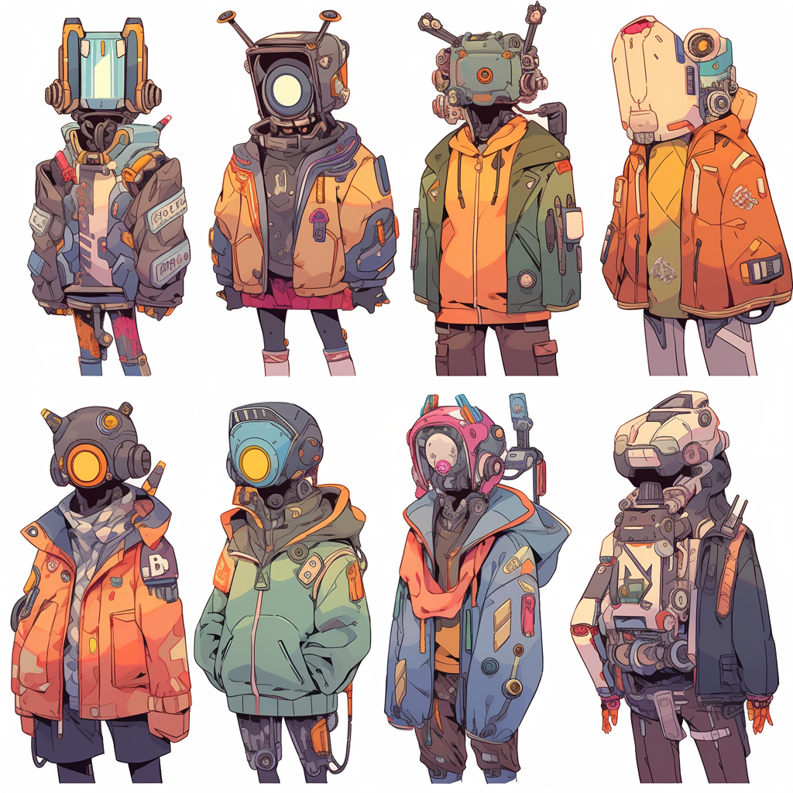
REST brought syntactic consistency
Similar clothes (JSON, HTTP verbs)
Similar coarse shape (PUT, PATCH, POST)
Lacking semantic meaning. Can’t usefully compose two APIs given only an OpenAPI spec. (concatenating routes doesn’t count)

Slide 16
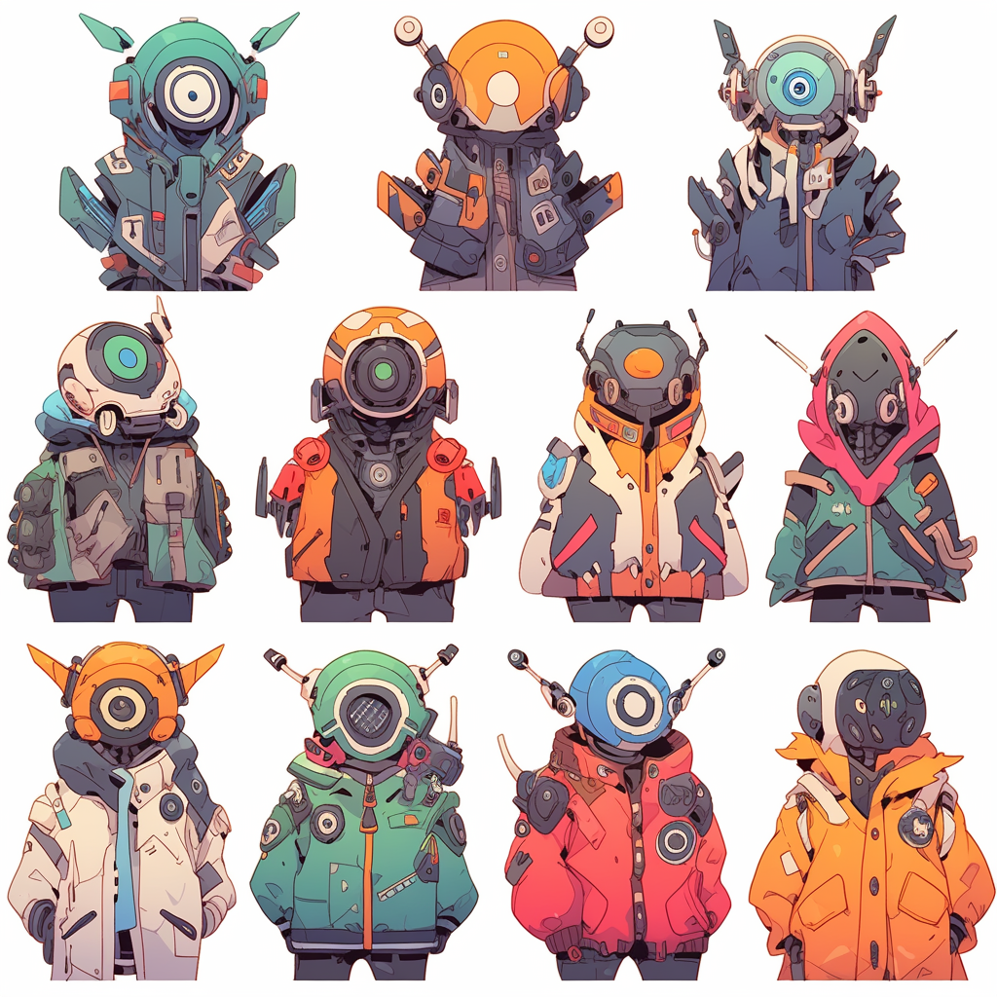
Ten Months ago, Semantic Compatibility Became Possible
Natural language in, natural language out.
Conveniently, this is also the API that humans support.
Now, it is possible to usefully compose multiple APIs.
Now, a human can intuitively take part in the exchange.
This seems important
API
Natural Language
Natural Language

Slide 17
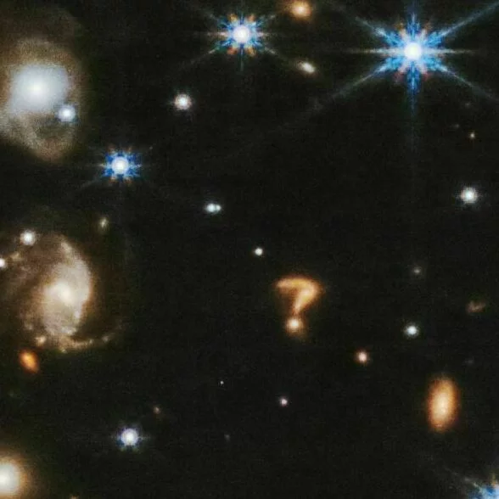
What if?
We framed our platforms as agents that consume and produce natural language as their APIs.
We exposed those agents using standard chat protocols (like XMPP)
We invited our customers to compose our platforms with others by inviting them to the chat and asking them to solve problems.
This is now a customer-centric vision for the future of operating systems.
2023. James Webb Space Telescope

Slide 18
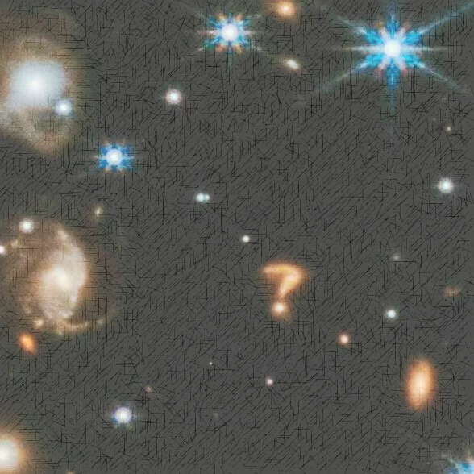
U
I want to publish a “latest releases” blog post.

Slide 19
U
I want to publish a “latest releases” blog post.
Here’s the plan: 1. clarify what “latest releases” means
2. Collect the latest releases from AHA
3. Ask writer to generate marketing copy
4. Ask CMP to publish using the AI workflow
Sound good?
C
U
Looks great. I mean items released to GA in the last month.

Slide 20
U
I want to publish a “latest releases” blog post.
Here’s the plan: 1. clarify what “latest releases” means
2. Collect the latest releases from AHA
3. Ask writer to generate marketing copy
4. Ask CMP to publish using the AI workflow
Sound good?
C
U
Looks great. I mean items released to GA in the last month.
@aha: what have we released to GA since September 2023?
A
C

Slide 21
3. Ask writer to generate marketing copy
4. Ask CMP to publish using the AI workflow
Sound good?
C
U
Looks great. I mean items released to GA in the last month.
@aha: what have we released to GA since September 2023?
A
C
Since September 2023, we have released: * Experiment collaboration: the industry-leading…
….
A
@writer: create a blog post detailing our latest releases
W
C

Slide 22
@aha: what have we released to GA since September 2023?
A
C
Since September 2023, we have released: * Experiment collaboration: the industry-leading…
….
A
@writer: create a blog post detailing our latest releases
W
C
Title: September releases
It’s been another banner month for Optimizely, with 4…
W
@cmp: route the post through your standard AI content approval process
M
C

Slide 23
released to GA since September 2023?
A
C
Since September 2023, we have released: * Experiment collaboration: the industry-leading…
….
A
@writer: create a blog post detailing our latest releases
W
C
Title: September releases
It’s been another banner month for Optimizely, with 4…
W
@cmp: route the post through your standard AI content approval process
M
C
Done. I’ll ping this channel when we’re ready to publish
M

Slide 24
There’s Room at this Table for Everyone

Slide 25
Isn’t this Inefficient?
Yes! Building a well-understood integration this way would be nuts.
Only some necessary things are well understood.
Wouldn’t determining if an integration mattered before we built it be fantastic?
This would be a revolution in product discovery. This seems important.

Slide 26
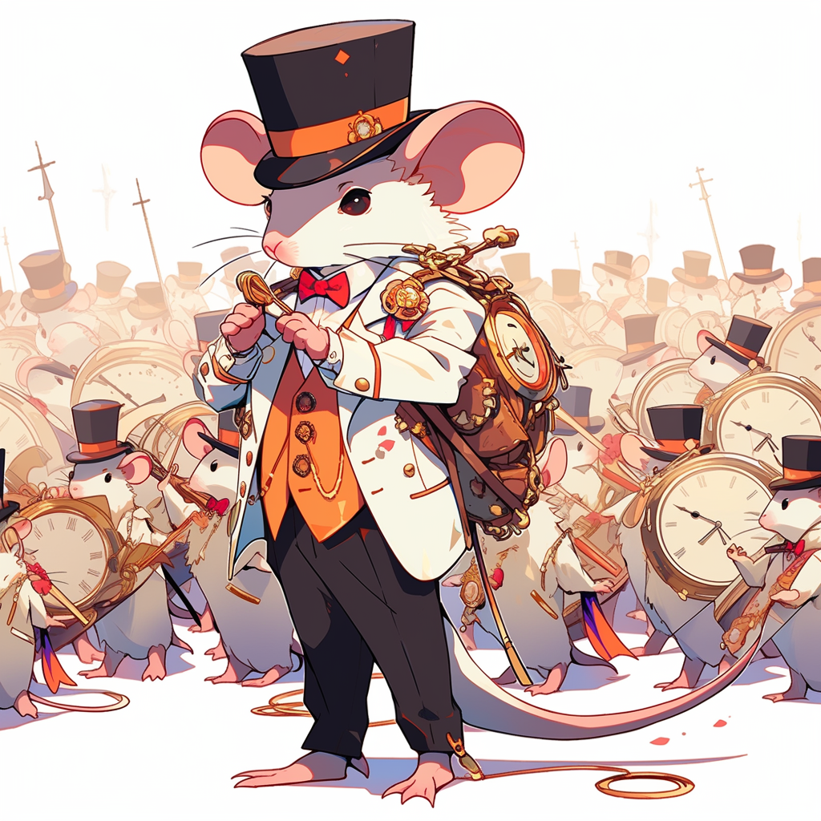
An analogy
Prototyping classifiers has moved from taking a team of data scientists a quarter to taking a PM a lunch break.
Deploying the prototype to production-level traffic would be nuts.
But, for the first time, we can prove a data science tool is valuable at a low cost.
Likewise, this seems important

Slide 27
It’s a bright future
I intend to prototype the coordinator soon.
I’d love to have others build early agents to validate the coordinator reference implementation.
Email me at brian.taylor@Optimizely.com and I’ll keep you posted

Slide 28
And, seriously
None of that was promises or announcements.
This is going to be fun!

