Slide 1


What’s new and coming in .NET
Jon Galloway
@jongalloway
Jon.Galloway@microsoft.com

Slide 2
















Build anything with a unified platform
CLOUD
WEB
DESKTOP
MOBILE
GAMING
IoT
AI
.NET
+
+
Visual Studio
Family
Visual Studio
Code
CLI
Linux
NuGet
GitHub
Components, tools, library vendors
Windows
macOS
TOOLS
OPERATING SYSTEM
ECOSYSTEM

Slide 3
Get Current with .NET 7
Get ready for .NET 8

Slide 4
.NET Schedule
Nov 2021
.NET 6.0
LTS
Nov 2022
.NET 7.0
Nov 2023
.NET 8.0
LTS
Nov 2024
.NET 9.0
Nov 2025
.NET 10.0
LTS
.NET 7.0 LTS released Nov 2022
Major releases every year in November
LTS for even numbered releases

Slide 5
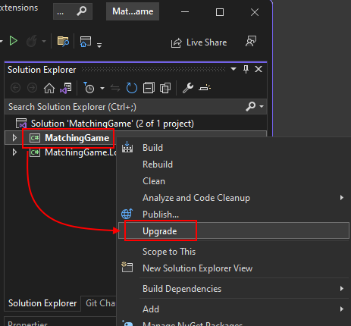
.NET Upgrade Assistant
Visual Studio + Command Line
Analyzers and code fixers
Ability to analyze binaries
UWP to Windows App SDK
Xamarin to .NET 7 & .NET MAUI
178K+
>4x
aka.ms/dotnet-upgrade-assistant
DOWNLOADS
YoY INCREASE

Slide 6

Every app can upgrade to the latest .NET
WinForms,
upgrade to .NET 7 with https://aka.ms/dotnet/upgrade
WPF
UWP upgrade to WinUI 3
Xamarin.Forms upgrade to .NET MAUI
WCF upgrade to .NET 7 with Core WCF
ASP.NET upgrade to ASP.NET Core
libraries .NET Framework & .NET -> .NET Standard2.0
Only from .NET 7 -> upgrade to .NET 7

Slide 7
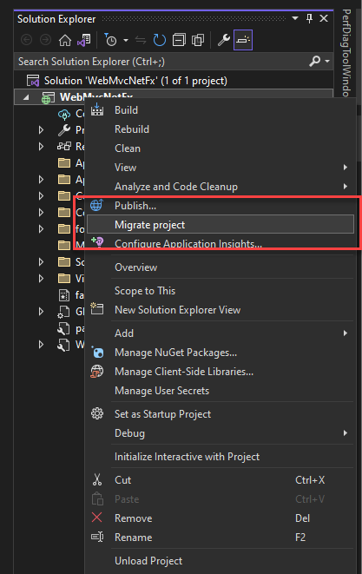
Incrementally upgrade to ASP.NET Core
Use Visual Studio to set up an ASP.NET Core migration project
YARP proxies requests from the new ASP.NET Core app to the existing ASP.NET app as needed
Migrate endpoints to ASP.NET Core one at time including any dependencies
Continue maintaining & developing your ASP.NET app while upgrading
Learn more
|
aka.ms/aspnet/upgrade

Slide 8
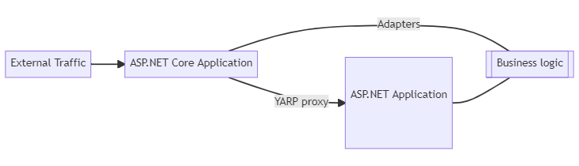
Incremental Migration to ASP.NET Core
YARP proxy
System.Web Adapters
https://devblogs.microsoft.com/dotnet/incremental-asp-net-to-asp-net-core-migration/

Slide 9
Adapters for System.Web
HttpContext
HttpContext.Current
HttpResponse
HttpRequest
HttpSessionState
HttpCookie
HttpCookieCollection
… and more

Slide 10
Demo
Upgrade Assistant with MVC
Silly bonus demo

Slide 11

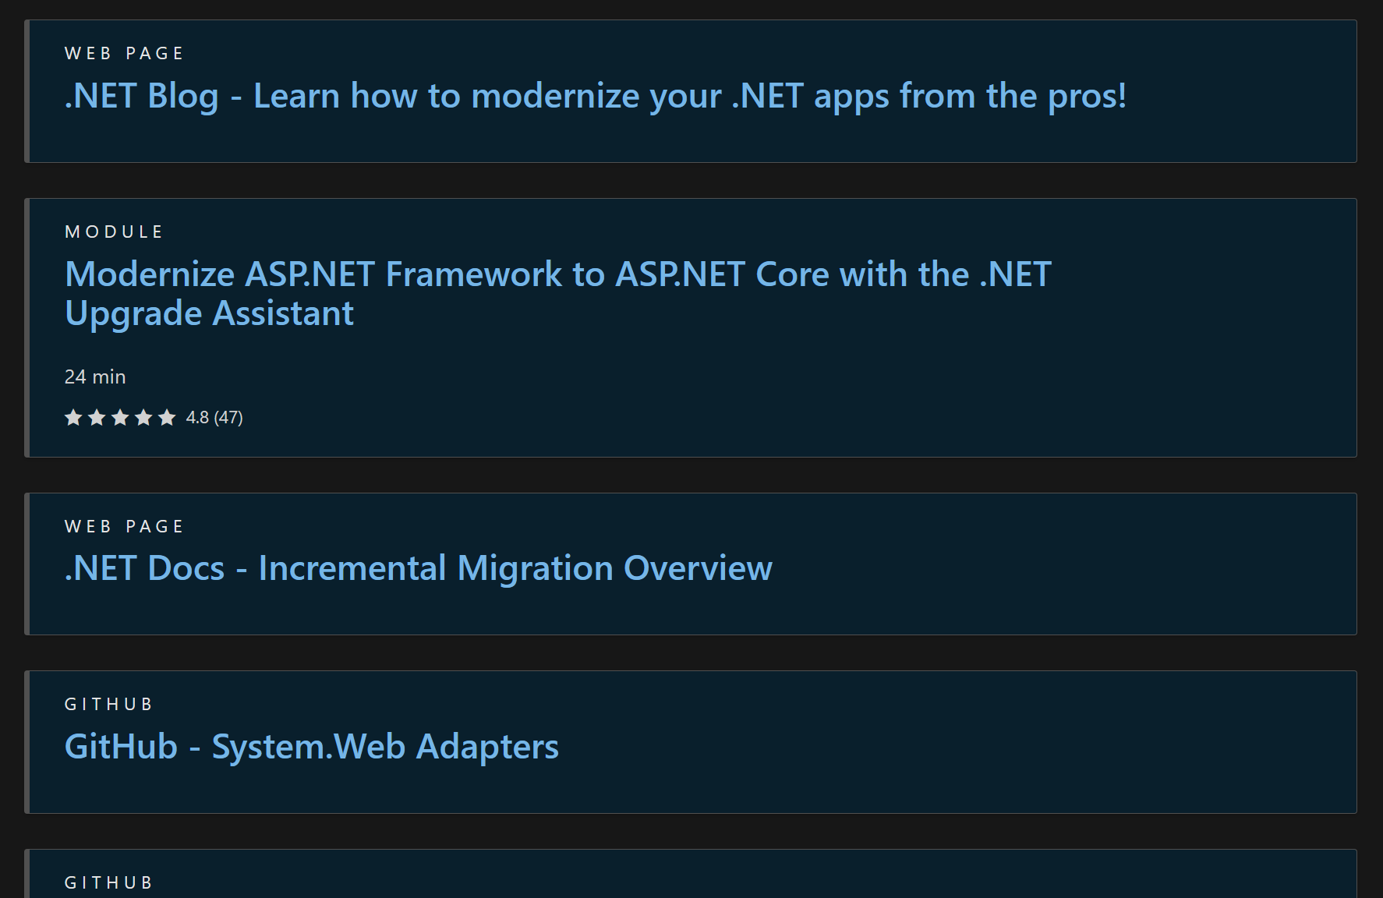
.NET App Modernization Resources
https://aka.ms/dotnet-modernization-resources

Slide 12
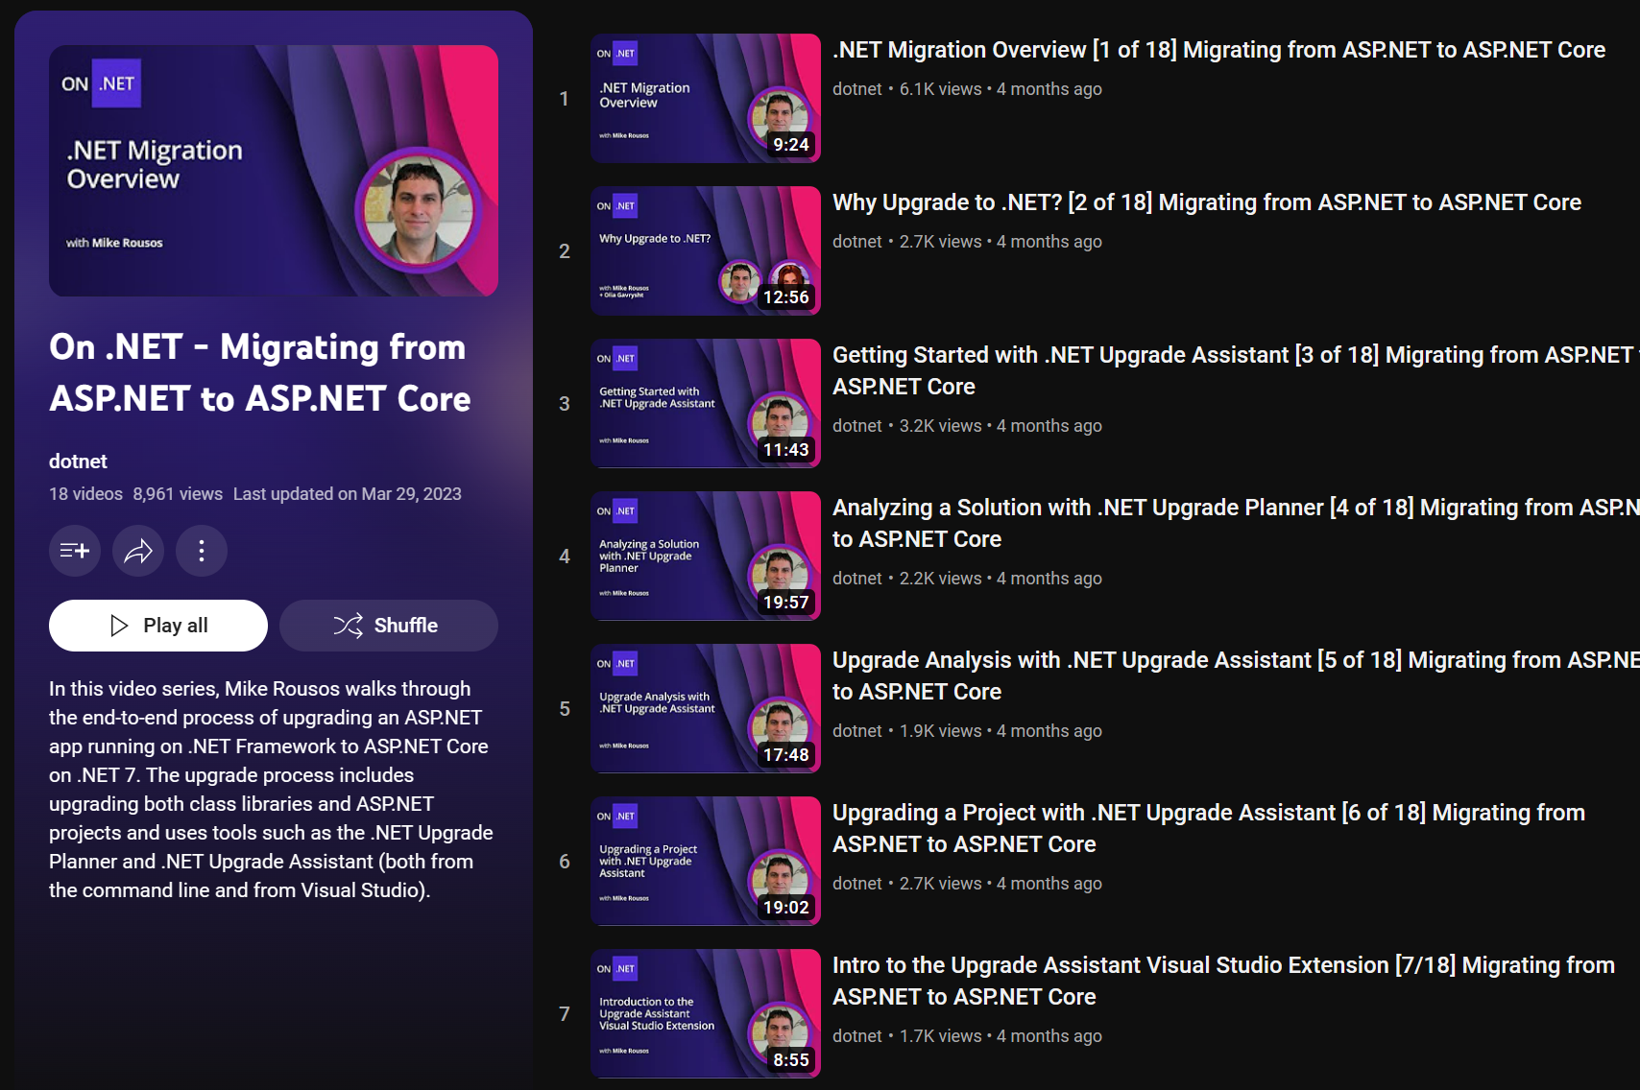
https://aka.ms/modernize-aspnet-videos

Slide 13
.NET 7 Highlights
Native support for ARM64
Enhanced .NET support on Linux
Unified
Build cross-platform mobile & desktop apps from same codebase
Improvements to API performance
Easy to build & deploy distributed cloud native apps
Modern
Simplify and write less code with C#11
HTTP/3 and minimal APIs improvements for cloud native apps
Simple
Productive
Dev Tunnels to easily develop and debug cloud API integrations
Configure, Build, Publish containers via .NET SDK - CLI and VS (coming soon)
get.dot.net/7

Slide 14
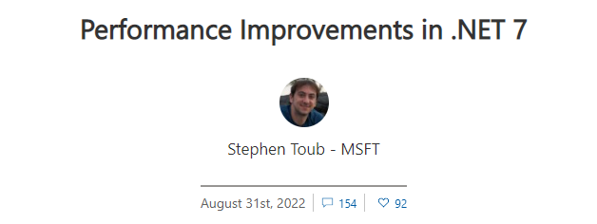
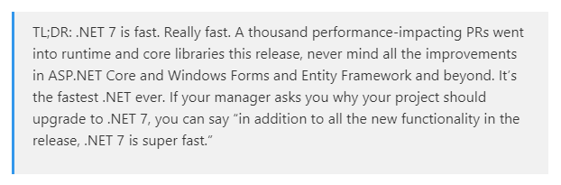
Performance Improvements in every release
Performance-related improvements
.NET 5
250+
.NET 6
550+
.NET 7
1000+

Slide 15






.NET at Microsoft
Teams upgrading to the latest version of .NET
Microsoft Graph
Azure Active Directory
Microsoft Teams
70B requests / day
37% CPU
91% Operational costs
185B requests / day
67% CPU
50% app efficiency
50 projects, 700+ APIs
25% CPU
60% P99 latency
Azure Cosmos DB
Exchange Online
Azure App Service
30-65% CPU
5x throughput
85% P95 latency
26% CPU
80% P99 latency
20% Heap size
⇧ 80% throughput
Large  in CPU
Enable gRPC & HTTP/2
Microsoft Graph's Journey to .NET 6
The Azure Cosmos DB Journey to .NET 6
Azure Active Directory's gateway is on .NET 6.0!
Exchange Online Journey to .NET Core
Microsoft Teams' journey to .NET Core
Microsoft Teams Assignments Service's Journey to .NET 6
A Heavy Lift: Bringing Kestrel + YARP to Azure App Services

Slide 16
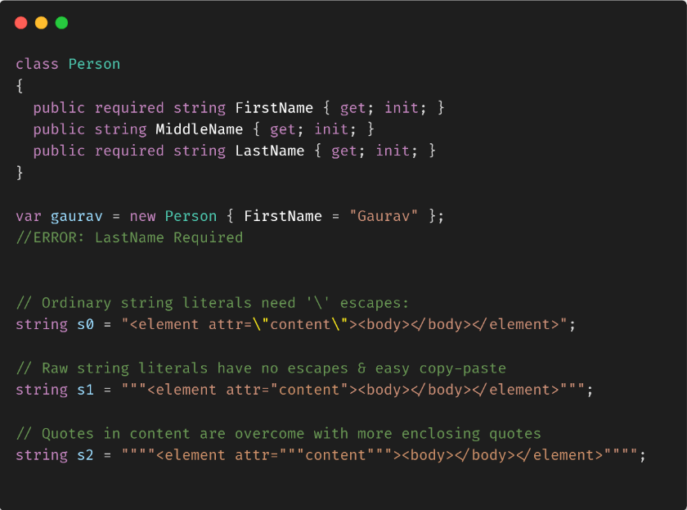
Simplify your code with C# 11
Syntactic simplifications, less boilerplate
Generic math support
List patterns
Required members
Raw string literals
General availability in .NET 7

Slide 17

Modern web with .NET
Runtime
APIs
Web UI
HTTP/3 & Faster HTTP/2 uploads
ARM64 support for Kestrel & IIS
Rate Limiting
Output caching
Auth Improvements with JWT
Route grouping
Enhanced OpenAPI support
gRPC JSON transcoding
Blazor custom elements
Data binding get/set/after modifiers
WebAssembly SIMD
Experimental QuickGrid

Slide 18
.NET 7 Performance - API
Continuous focus on improvement:
Plaintext: 8% more RPS
JSON: 16% more RPS
Fortunes: 25% more RPS
Tech Empower JSON
+16%
Source: https://www.techempower.com/benchmarks/#section=data-r21&hw=ph&test=json

Slide 19
.NET Data and Entity Framework Core
New Features in .NET 7
Distributed transactions
Mapping to JSON columns for SQL
SaveChanges performance and bulk updates
Custom reverse engineering templates
Stored procedures for insert/update/delete
Time to insert multiple rows
milliseconds (lower is better)
4x faster
4 Rows - SaveChangesAsync
Source: https://devblogs.microsoft.com/dotnet/announcing-ef-core-7-preview6-performance-optimizations/

Slide 20
gRPC
High performance cross-platform contract-first cloud native APIs
Requests Per Second (Higher is Better)
99.8K
96.1K
89.4K
72.5K
68.9K
Java
Go
C++
Rust
.NET 7
Source: https://github.com/LesnyRumcajs/grpc_bench/wiki

Slide 21
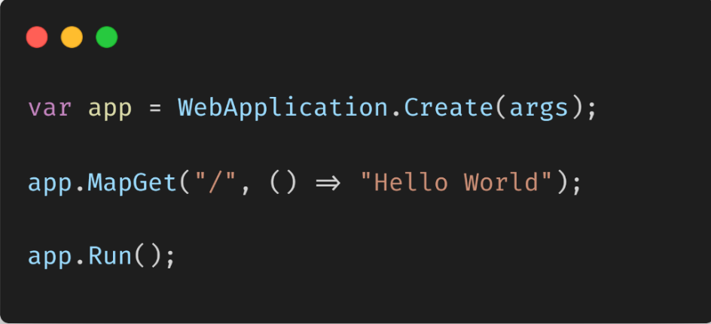
.NET REST APIs – Minimal
Lightweight, single-file, cloud native APIs
Low ceremony, top-level C# programs
Easy to get started
Scale to any app size

Slide 22
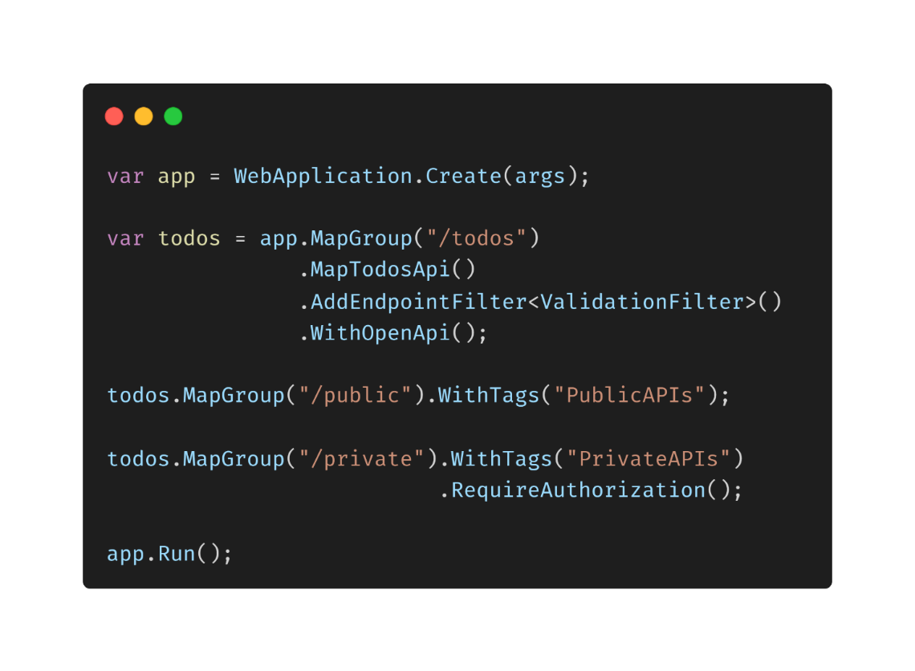
.NET REST APIs – Powerful
Organize groups of endpoints
Leverage endpoint filters for validation,
logging, and much more
Improved testing and OpenAPI docs

Slide 23
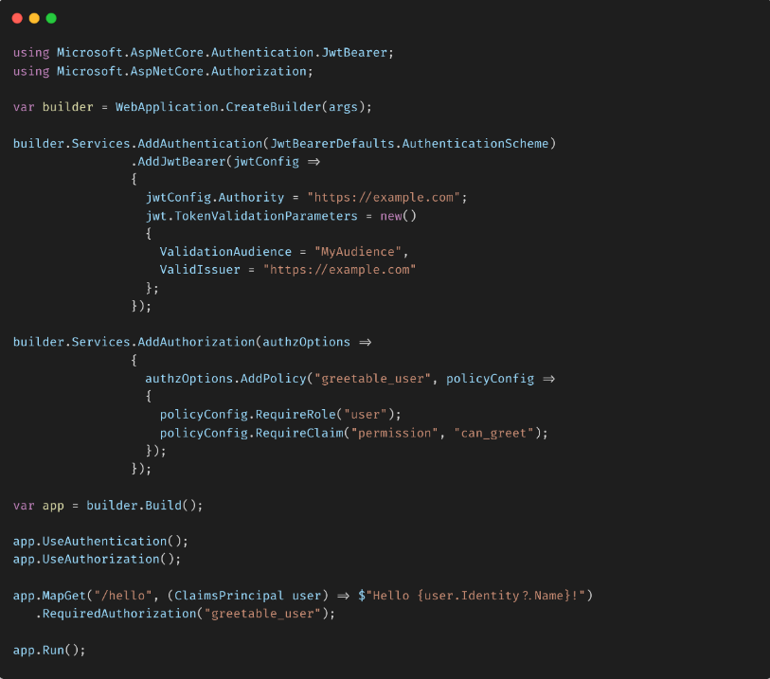
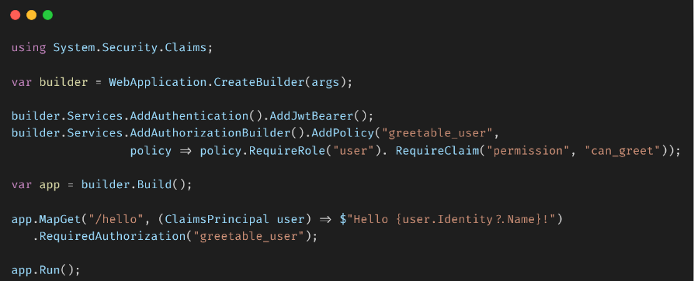
.NET REST APIs – Secure
.NET 6
.NET 7

Slide 24
.NET 7 – Rate Limiting Middleware
public class MyController : Controller
{ [EnableRateLimitingAttribute("MyControllerPolicy")]
public IActionResult Index()
{
return View();
}
}
app.MapGroup("/public/todos").RequireRateLimiting("MyGroupPolicy");

Slide 25
Demo
Minimal APIs
New Middleware

Slide 26


.NET MAUI
Build native, cross-platform desktop & mobile apps all in one framework
One Base Class Library
Type Unification
CLI Support
SDK Style Projects
Modern Support Lifecycle
.NET
Unified .NET
.NET MAUI
Mobile, desktop, hybrid
Android
iOS
WinUI
Mac Catalyst
Blazor WebView
Windows
Mac
Catalyst
iOS
Android
Single Project
Microsoft.Extensions
.NET Hot Reload
XAML Hot Reload
Visual Diagnostics
Productive development
macOS
iOS

Slide 27
.NET MAUI Momentum
636%
18.8K
GROWTH YEAR OVER YEAR
STARS ON GITHUB
1.8K
PULL REQUEST

Slide 28

Blazor in .NET 7
Blazor Hybrid with .NET MAUI
Custom elements
Handle location changing events
Bind after/get/set modifier
Dynamic authentication requests
Improved JavaScript interop on WebAssembly
WebAssembly SIMD & exception handling
…and much more!
blazor.net
aka.ms/blazor-in-dotnet-7

Slide 29
✅ Get Current with .NET 7
👀 Get ready for .NET 8

Slide 30
.NET Future
Source Generators
Interceptors
AOT

Slide 31


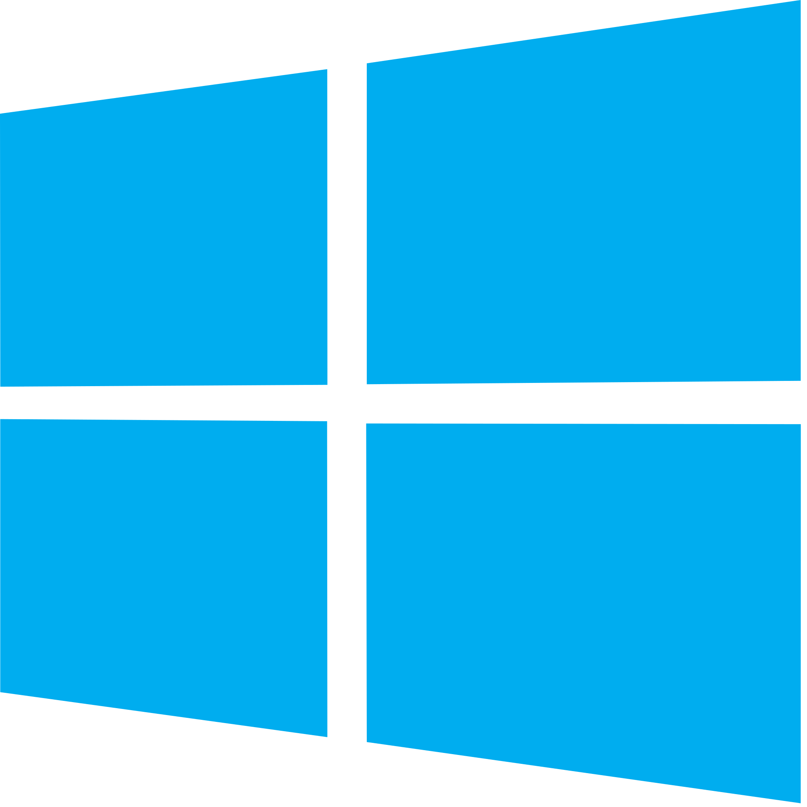
Before Native AOT
88.3 MB
235 MB
182 ms
668K
88.7 MB
231 MB
287 ms
707K
Published
Size
Working
Set
Startup
RPS
Published
Size
Working
Set
Startup
RPS
Linux
Windows

Slide 32
Progress so far
Reduced disk footprint
Reduced startup time
689K
Reduced memory demand
670K
54 ms
33 MB
27 ms
45 MB
8.04 MB
7.49 MB
Published
Size
Working
Set
Startup
RPS
Published
Size
Working
Set
Startup
RPS
Linux
Windows

Slide 33
Demo
AOT

Slide 34
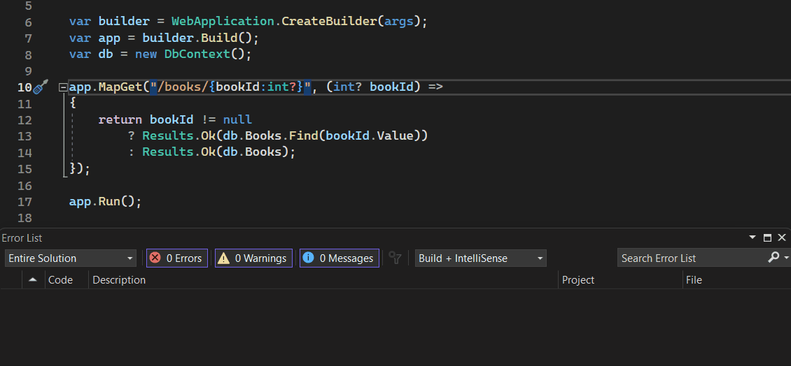
Route Tooling
Syntax Highlighting
Autocomplete
Analyzers and Fixers

Slide 35
Demo
Route Tooling

Slide 36





Blazor in .NET 8: The best of server & client
Blazor
MVC &
Razor Pages
Blazor
Server-side rendering (SSR) 🚀
Client-side rendering (CSR) 🎮

Slide 37
Server-side rendering
HTML
Blazor
GET

Slide 38
Streaming rendering
HTML
HTML
Blazor
Loading…
SQL
GET

Slide 39

Enhanced navigation & form handling
HTML
Blazor
fetch

Slide 40

Choose render mode at runtime
Blazor
WebSocket

Slide 41
Full stack web UI with Blazor
Server-side rendering
Enhanced navigation & form handling
Streaming rendering
Add client interactivity per component or page
Choose component render mode at runtime

Slide 42
Generate static HTML content with components
Use components for templating and static HTML rendering
Render a component directly to a string or stream
Render outside of the context of ASP.NET Core
Investigating static site generation with Blazor post-.NET 8

Slide 43
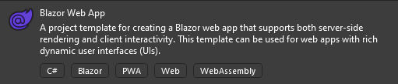
New Blazor Web App template
Best of Blazor Server & Blazor WebAssembly in one template
Quickly get setup with server-side rendering (SSR) & progressive enhancements
Easily enable Server & WebAssembly interactive render modes

Slide 44
.NET WebAssembly improvements
SIMD & exception handling
Jiterpreter
20% faster UI rendering
2x faster JSON deserialization
Multithreading
CSP compatibility
Hot reload improvements
Web-friendly packaging (Webcil)

Slide 45
Additional Blazor enhancements in .NET 8
QuickGrid
Sections
Route to
named element
Monitor
circuit activity
Improved
authentication

Slide 46
APIs
Form handling
Problem details
API development experience
Helpful analyzers

Slide 47



Authentication and Authorization Improvements
Enhancements for Single Page Applications (SPA)
Client-friendly endpoints for identity management
Support for tokens
in self host scenarios
(without OIDC server)
Remove IdentityServer from templates
(option for OIDC)
Simplified custom policies with IAuthorizationRequirementData

Slide 48
Self-hosted identity
Client UI
Endpoints
Identity Manager
Razor Page UI
User Manager
Role Manager
Sign in Manager
Identity Store
Users
User Claims
Roles
User Logins
Data Access (EF Core)
Database

Slide 49
High-scale and high-availability services in .NET 8
Resilience
Compliance
Microsoft.Extensions.Resilience
Microsoft.Extensions.Compliance.Abstractions
Microsoft.Extensions.Http.Resilience
Microsoft.Extensions.Compliance.Redaction
Adds fault injection and retry pipelines
Adds data classification and redaction
Telemetry
Microsoft.Extensions.Telemetry
Microsoft.Extensions.Telemetry.Abstractions
Microsoft.Extensions.Telemetry.Console
Microsoft.Extensions.Http.Telemetry
Primarily add Logging enhancements and meters/metrics

Slide 50
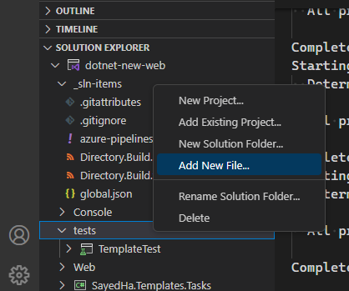
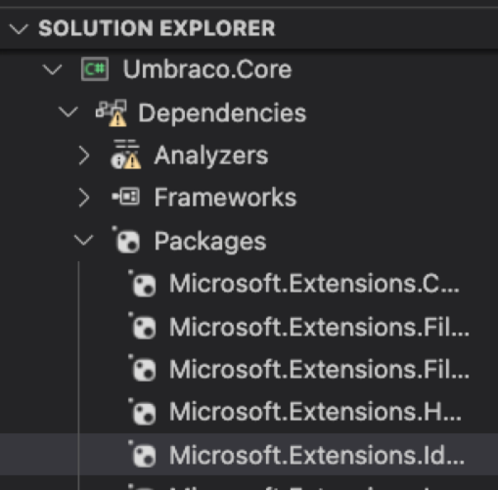





C# Dev Kit for
Visual Studio Code
Visual Studio productivity features in Visual Studio Code
Powered by LSP for performance & reliability
Included in Microsoft Dev Box and GitHub Codespaces
Solution & Project Management
AI-assisted coding
Test Explorer

Slide 51
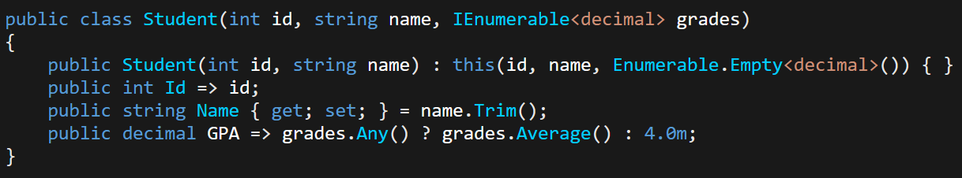
C# 12

Slide 52
Common cloud-native scenarios
Modernize business- critical applications
AI-powered apps
SaaS delivery
Geo-distributed applications
Run applications anywhere
Real-time telemetry

Slide 53





Azure Container Apps
Azure Kubernetes Service
Security
Building cloud-native on Azure
Serverless
Clusters
DevOps
GitHub
APIs
Data
Visual Studio
Observability
Messaging
AI
OSS Ecosystem

Slide 54





Run your containers your way for different needs
Simplicity
Control
Azure Container Apps
Azure Kubernetes Service
Time to market
Scale to zero
Embedded app patterns
More dev, less ops
Industry standard
OSS ecosystem access
Customization
Rich access policies

Slide 55
High-scale and high-availability services in .NET 8
Resilience
Compliance
Microsoft.Extensions.Resilience
Microsoft.Extensions.Compliance.Abstractions
Microsoft.Extensions.Http.Resilience
Microsoft.Extensions.Compliance.Redaction
Adds fault injection and retry pipelines
Adds data classification and redaction
Telemetry
Microsoft.Extensions.Telemetry
Microsoft.Extensions.Telemetry.Abstractions
Microsoft.Extensions.Telemetry.Console
Microsoft.Extensions.Http.Telemetry
Primarily add Logging enhancements and meters/metrics

Slide 56



Your data
AI
Chat-based
intelligent agent
What is included in my health plan that is not standard?
I’m generating an answer… Please wait.
Northwind Health Plus offers additional benefits to Northwind Standard plan members such as coverage for some vision and dental care, mental health services, and some alternative treatments.¹
Citations: Northwind_Health_Plus_Benefits_Details-108.pdf

Slide 57







Empower your applications with Azure AI
Applied AI Services
Bot Service
Cognitive Search
Form Recognizer
Video Indexer
Metrics Advisor
Immersive Reader
Cognitive Services
Vision
Speech
Language
Decision
OpenAI Service
ML Platform
Azure Machine Learning

Slide 58
Intelligent enterprise apps
Your data
AI
Intelligent App

Slide 59

Your data
AI
Intelligent App
  Welcome to Contoso Electronics! We are excited to offer our employees two comprehensive health
  insurance plans through Northwind Health.
Northwind Health Plus
  Northwind Health Plus is a comprehensive plan that provides comprehensive coverage for medical,
  vision, and dental services. This plan also offers prescription drug coverage, mental health and substance
  abuse coverage, and coverage for preventive care services. With Northwind Health Plus, you can choose
  from a variety of in-network providers, including primary care physicians, specialists, hospitals, and
  pharmacies. This plan also offers coverage for emergency services, both in-network and out-of-network.
Northwind Standard
  Northwind Standard is a basic plan that provides coverage for medical, vision, and dental services. This
  plan also offers coverage for preventive care services, as well as prescription drug coverage. With
  Northwind Standard, you can choose from a variety of in-network providers, including primary care
  physicians, specialists, hospitals, and pharmacies. This plan does not offer coverage for emergency
  services, mental health and substance abuse coverage, or out-of-network services.
Comparison of Plans
  Both plans offer coverage for routine physicals, well-child visits, immunizations, and other preventive
  care services. The plans also cover preventive care services such as mammograms, colonoscopies, and
  other cancer screenings.
  Northwind Health Plus offers more comprehensive coverage than Northwind Standard. This plan offers
  coverage for emergency services, both in-network and out-of-network, as well as mental health and
  substance abuse coverage. Northwind Standard does not offer coverage for emergency services, mental
  health and substance abuse coverage, or out-of-network services.
  Both plans offer coverage for prescription drugs. Northwind Health Plus offers a wider range of
  prescription drug coverage than Northwind Standard. Northwind Health Plus covers generic, brandname,
  and specialty drugs, while Northwind Standard only covers generic and brand-name drugs.
  Both plans offer coverage for vision and dental services. Northwind Health Plus offers coverage for vision
  exams, glasses, and contact lenses, as well as dental exams, cleanings, and fillings. Northwind Standard
  only offers coverage for vision exams and glasses.
  Both plans offer coverage for medical services. Northwind Health Plus offers coverage for hospital stays,
  doctor visits, lab tests, and X-rays. Northwind Standard only offers coverage for doctor visits and lab
  tests.
  Northwind Health Plus is a comprehensive plan that offers more coverage than Northwind Standard.
  Northwind Health Plus offers coverage for emergency services, mental health and substance abuse
  coverage, and out-of-network services, while Northwind Standard does not. Northwind Health Plus also

Slide 60
Your data
AI
Intelligent App
  Welcome to Contoso Electronics! We are excited to offer our employees two comprehensive health
  insurance plans through Northwind Health.
Northwind Health Plus
  Northwind Health Plus is a comprehensive plan that provides comprehensive coverage for medical,
  vision, and dental services. This plan also offers prescription drug coverage, mental health and substance
  abuse coverage, and coverage for preventive care services. With Northwind Health Plus, you can choose
  from a variety of in-network providers, including primary care physicians, specialists, hospitals, and
  pharmacies. This plan also offers coverage for emergency services, both in-network and out-of-network.
Northwind Standard
  Northwind Standard is a basic plan that provides coverage for medical, vision, and dental services. This
  plan also offers coverage for preventive care services, as well as prescription drug coverage. With
  Northwind Standard, you can choose from a variety of in-network providers, including primary care
  physicians, specialists, hospitals, and pharmacies. This plan does not offer coverage for emergency
  services, mental health and substance abuse coverage, or out-of-network services.
Comparison of Plans
  Both plans offer coverage for routine physicals, well-child visits, immunizations, and other preventive
  care services. The plans also cover preventive care services such as mammograms, colonoscopies, and
  other cancer screenings.
  Northwind Health Plus offers more comprehensive coverage than Northwind Standard. This plan offers
  coverage for emergency services, both in-network and out-of-network, as well as mental health and
  substance abuse coverage. Northwind Standard does not offer coverage for emergency services, mental
  health and substance abuse coverage, or out-of-network services.
  Both plans offer coverage for prescription drugs. Northwind Health Plus offers a wider range of
  prescription drug coverage than Northwind Standard. Northwind Health Plus covers generic, brandname,
  and specialty drugs, while Northwind Standard only covers generic and brand-name drugs.
  Both plans offer coverage for vision and dental services. Northwind Health Plus offers coverage for vision
  exams, glasses, and contact lenses, as well as dental exams, cleanings, and fillings. Northwind Standard
  only offers coverage for vision exams and glasses.
  Both plans offer coverage for medical services. Northwind Health Plus offers coverage for hospital stays,
  doctor visits, lab tests, and X-rays. Northwind Standard only offers coverage for doctor visits and lab
  tests.
  Northwind Health Plus is a comprehensive plan that offers more coverage than Northwind Standard.
  Northwind Health Plus offers coverage for emergency services, mental health and substance abuse
  coverage, and out-of-network services, while Northwind Standard does not. Northwind Health Plus also

Slide 61
Demo: Intelligent Chat App

Slide 62
Get Current with .NET 7
Get ready for .NET 8

Slide 63








Follow .NET – dot.net
aka.ms/dotnet/blog
aka.ms/dotnet/twitter
aka.ms/dotnet/mastodon
aka.ms/dotnet/youtube
aka.ms/dotnet/forums
aka.ms/dotnet/tiktok
aka.ms/dotnet/linkedin
aka.ms/dotnet/facebook
aka.ms/dotnet/github

Slide 64

.NET
Get started with .NET 7 today!
dot.net/learn
Try out the latest .NET 8 preview
get.dot.net/8

Slide 65
Thank You!
Let's build amazing apps with .NET 7
get.dot.net/7

