Slide 1
OMVP Summit
Tech Partner Philosophy and Adoption of Expanded Network
Jeff Cheal
VP, Strategic & Tech Partners

Slide 3
Whats new?
Or
Why should I pay attention?
Proactive vs Reactive
Who works on integrations?
Parnterships focused on resell

Slide 4
“As part of our evaluation, we are looking for a platform that integrates with X”
Tech Partners are our X, and that’s why picking and cultivating these relationships is so important

Slide 5
Signs we are Succeeding
I love to say “yes we do”
We have stark raving fans
Together we bring more value
We use each others’ entropy
We build partnerships so that our team can say “yes we integrate” to answer customers needs
Customers stay with both of us because we make each other sticky and want to share joint success
We are not the centers of our own universe. To customers we are all stars in their galaxy but we bring more joint value with our gravity
We stand each other up and we give each other wind to our sails

Slide 6
Our Three Concentrations of Partnership Execution
Co-sell
Ability to create bi-directional pipeline with partners and support the winning of new logos
GTM
Efforts we and our partner execute on together to promote the combined value of our brands
Build-With
Build connectors and integrations between two products to solve customer joint use-cases
KPI
# of Opportunities Created
Win Rate
Sourced/Influenced Bookings
# of Leads Captured
Case Studies
# of Usable assets
# of customers using connector
NPS Score with Customer
Effort Drives
Optimizely Booking Goals
Increased opportunities to Co-Sell
Stronger co-value proposition
Increased Target Addressable Market
Tactics
Account Mapping
Lead Sharing
Sales Bridging
Marketing Events
Co-branded Collateral
Joint Marketing Mix
Tech Lead Bridging
Commit to Integration
Co-solutioning Execution

Slide 7
01
How does Optimizely Pick Partners?

Slide 8
Customer Value from Partnerships
Brand Elevation
Collaborate with the world’s best brands in their own verticals to lift the visibility of our brand to our customers
Capabilities Extension
Provide features and use cases that go beyond what Optimizely is typically able to provide ourselves, pairing our products with industry-leading tools that our mutual customers purchase to create outsized complete solutions
Product Stickiness
Effective combinations of products multiply retention value in creating a customer’s preferred stack and raise Optimizely’s retention by connecting it with other product’s retention value
TAM & Pipeline Expansion
Partnerships must be measured on their ability to expand interest in our products to more customers and show results by measuring their entrance to our sales ecosystem

Slide 9
Things I believe in
Things I believe in
Things I believe in
Things I believe in
Things I believe in

Slide 10
Our products meet our customers at compelling events
Our best partnerships work with our Solutions Partners to drive complete value propositions, often with multiple partners together
This means we are focused on partnerships across multiple tech partners that drive to personas

Slide 11
Sample: Product Manager
Supported by
Cloud Partner
Driving Cloud Consumption
Solutions Partner
Foused around a joint services offering
Tag Management
Journey Analytics
Customer Data
Experimentation
Segment
Tealium
GA4
Quantum Metric
Contentsquare
FullStory
Zeotap
Lytics
mParticle
Web or Feature Experimentation
Focused on Personalization and activation

Slide 12
We will integrate with Competitors
We have too many product combinations, some that drive large areas of or business that we must continue to support. We will not turn to an Optimizely-first or Optimizely-only tech stack
Upgrading our integration between Feature Experimentation and Contentful
We are working to integrate Web Experimentation with Shopify
We recently released a CMS integration to Salesforce Commerce

Slide 13
We are driven on a mutual referral business
Good technology GTM partnerships are predicated on a mutual referral program, meaning we are as active at referring logos to other partners as we are at seeking out referrals for new business
We view our Tech Partner Channel is a revenue driver where in years past its been aspirational or a should-have

Slide 14
Not all integrations come with a GTM Plan
Some of our biggest focus integrations do not have a joint GTM plan because of their requirements
This means you will hear the most about partnerships that have the strongest GTM from a co-marketing perspective, but we will continue to have a hyperfocus on any integration that helps win rate and retention (Slack, Teams etc)

Slide 15
Tech Partner Integrations cannot be a reason we lose
We are focused at parody with the competition when it comes to a fulfilled set of technology partnerships, and are equally focused at retaining these partnerships to keep them updated

Slide 16
02
How Optimizely Integrates

Slide 17






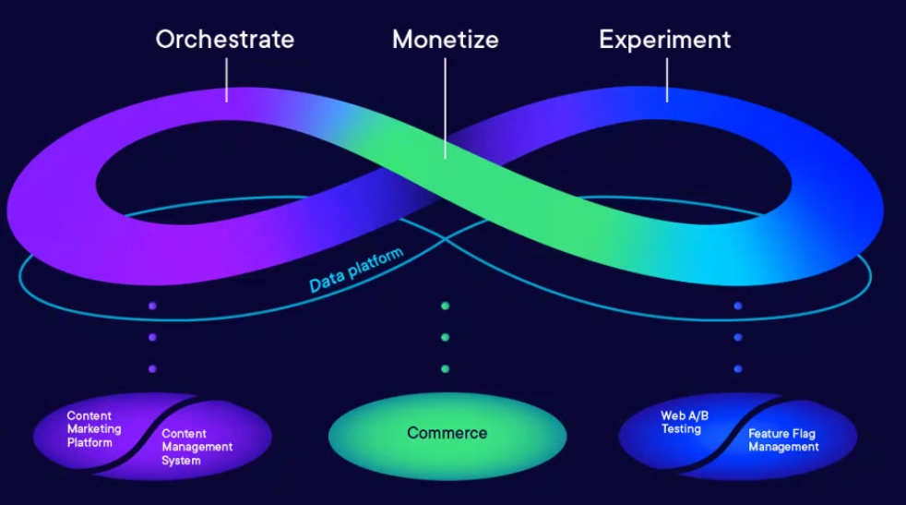

















Our priority technology partners
Advertising
Loyalty
Data-warehousing
Search
User research
Translation
Cloud platform
Tax
Punchout
Experience analytics
PIM
SEO, QA & accessibility
Voice of the customer
CRM
Content delivery
Marketing
automation
Asset management
Performance monitoring
Collaboration
Notes:
We have a wide-ranging ecosystem, working with dozens of other technology partners. Our focus partners are shown above.

Slide 18
Current GTM/Co-Sell Partnership Landscape
Product Solution
Orchestrate
Experiment
Monetize
CMS
CMP
WebX
FeatX
Customized
Configured
Strategic Partners
Microsoft
Google
Microsoft
Technology Partners
Platinum
Siteimprove
Contentsquare
Fullstory
Quantum Metric
Technology Partners
Gold
Digizuite
Heap
inriver
Tealium
Hawksearch
6sense
Zeotap
UserTesting
Qualtrics

Slide 19
Projected GTM/Co-Sell Partnership Landscape
Product Solution
Orchestrate
Experiment
Monetize
CMS
CMP
WebX
FeatX
Customized
Configured
Strategic Partners
Microsoft
Google
Microsoft
Technology Partners
Platinum
Siteimprove
Contentsquare
Fullstory
Bolt
Vercel
Quantum Metric
Technology Partners
Gold
Digizuite
Heap
inriver
Tealium
Hawksearch
6sense
Zeotap
UserTesting
Qualtrics

Slide 20
Projected Build-With Partnership Landscape
Product Solution
Orchestrate
Experiment
Monetize
CMS
CMP
ODP
CREC
WebX
FeatX
Customized
Configured
PREC
Strategic Partners
Microsoft
Microsoft
Google
Microsoft
Technology Partners
Platinum
Vercel
Contentsquare
Fullstory
Bolt
Quantum Metric
Technology Partners
Gold
Digizuite
Tealium
6sense
Tealium
inriver
Siteimprove
UserTesting
Heap
Hawksearch
Qualtrics
Zeotap
Technology Partners
Untiered or Silver
Google
Salesforce
Shopify
Salesforce
Baymard
Slack
Punchout
6sense
Hubspot
YouTube
Magento
Marketo
Slack
Indago
Klarna
Shopspray
Eloqua
Sprout Social
Facebook
6sense
Avensia
infor
Marketo
Figma
Google
Adobe
Stripe
Salesforce
Adobe
Hubspot
Segment
Aumatica

Slide 21
Key Use Cases – Web Experimentation
Web Experimentation
Gets Data From
Pushes Data To
INITIAL
BUILD/PURCHASE
WITH
Tag/Event Management
Test Management
Customer Segmentation
Customer Data Enrichment
User Research
Journey Analytics (Marketing)
User Feedback
Notifications/Productivity
Marketing Analytics
Marketing Automation

Slide 22
Key Use Cases – Content Management
Content Management
Gets Data From
Pushes Data To
INITIAL
BUILD/PURCHASE
WITH
Asset Management
Aprimo, Digizuite, Optimizely Owns Tool
CMS-focused Premium Search
Certona
Workflow/CMP
Aprimo, Sharepoint
Accessibility
SiteImprove
Translation
Translation.com
CRM/Marketing Automation
SF, HubSpot, Marketo, Optimizely Owns a Tool
Video
No current partners
Analytics
Google Analytics, Optimizely Owns Tool
Site Personalization/Segmentation
Optimizely Owns Tool
Social
Hootsuite, Sprinklr
Chat
LivePerson

Slide 23
Key Use Cases – Headless Content Management
Content Management
Gets Data From
Pushes Data To
INITIAL BUILD/PURCHASE
WITH
Asset Management
Aprimo, Digizuite, Sharepoint, Optimizely Owns Tool
Front End Development
Vercel, Netify
Search
Certona
Workflow/CMP
Aprimo, Optimizely Owns Tool
Translation
Translation.com
Accessibility
SiteImprove
Video
No current partners
CRM/Marketing Automation
HubSpot, Marketo, Optimizely Owns a Tool
Site Personalization/Segmentation
Optimizely Owns Tool
Analytics
Google Analytics, Optimizely Owns Tool

Slide 24
Projected Build-With Partnership Landscape
Lead with Headless (Support our Big Bets)
Our team will focus on Tech Partners and product verticals that enhance our headless position (Vercel, other Front-end frameworks + additional headless components)
Establish Premium Options
The team will continue to support build-with relationships with premium alternatives (Search and PIM for Commerce, SAP or Salesforce) to assure that customers looking for premium point solution alternatives can still consider our premium solutions in tandem
Integrate with Industry Leaders
Investing in relationships with Slack and Teams assure that our products integrate with industry leading solutions while these won’t drive GTM motions
Focus on Key Use Cases
Passthrough for ODP represents a key unlocking use case for our own products. This then requires us to build and maintain relationships with competitive products to our CDP (Segment, mParticle), and while these relationships won’t drive pipeline they are key to “completing” our product story

Slide 25
Types of Build-With Executions
Optimizely
Tech Partner
Who Builds?
Optimizely (Native Feature or Connector) or SI
1. Push – Optimizely pushes data to another tool
(Web X pushing to GA4)
2. Pull – Optimizely fetches data from another tool
(Web X pulls from Tealium Audiences)
3. Push – Third-Party pushes data to Optimizely
(Segment pushes data to Segment)
Who Builds?
Partner (Native Feature) or SI
4. Pull – Third-Party pulls data from Optimizely
(Zapier pulls data from Optimizely Data Platform to send out to other tools)

Slide 26
Four Tiers of Build-With Integrations
Tier 1 - Native
Any integration listed in our application
Owned by our product/engineering to build and maintain (should be reviewed and updated annually)
Documentation Hosted and managed in Optimizely Documentation
How to Support Customers get support via support portal, directly from Optimizely
App Marketplace Connector is listed in Marketplace
How to Install Connector is installed via product provisioning vs extension
Product Marketing Should have a one-sheeter on shared value via PMM
Value Proposition Indicates a connector natively installed in Optimizely Web that either pushes data out from or pulls data into Web Experimentation, not using another platform

Slide 27
Four Tiers of Build-With Integrations
Any integration not listed in our application that can be installed
Not owned directly by product/engineering, but could be built by someone at Optimizely or Third Party
Installation Typically installed via GitHub or repository
Documentation Hosted documentation on Optimizely documentation site
How to Support Customers get support via support portal, directly from Optimizely with help of escalation point
App Marketplace Connector is listed in Marketplace
How to Install Connector must have clear installation directions, hosted on landing page
Requires GTM/Cosell? Does not require a GTM or cosell relationship with partner
Product Marketing Should have a one-sheeter on shared value via Tech Partner Team in conjunction with PMM
Value Proposition Indicates a connector not natively installed, but introduced as native code in Optimizely Web that either pushes data out from or pulls data into Web Experimentation, not using another platform
Tier 2 – Non-Native

Slide 28
Four Tiers of Build-With Integrations
Any integration listed in other tech platforms that push to Optimizely
Not owned directly by product/engineering, but could be built by someone at Optimizely or Third Party
Installation Typically installed within the tech partner platform
Documentation Documentation should be hosted on partner’s site
How to Support Customers get support via tech partner's support
App Marketplace Connector is listed in Marketplace - links must be up to date
How to Install Connector must have clear installation directions, hosted on landing page
Product Marketing Should have a one-sheeter on shared value
Value Proposition Indicates a connector installed in partner platform that pushes to or pulls from Optimizely Web
Connector Mix Tech partner can have both a Tier 3 + Tier 1/2 Connector as information can go both ways (Tealium, Segment)
Tier 3 – External

Slide 29
Four Tiers of Build-With Integrations
Any integration using a third-party tool (Tray.io) to integrate to Optimizely
Not owned directly by product/engineering, but could be built by someone at Optimizely or Third Party
Installation Typically installed within the third-party tool (Zapier, Tray.io)
Documentation Documentation must be up to date (owned by Tech Partner team to engage with external team to keep updated)
How to Support Customers get support via clear path spelled out on landing page
App Marketplace Connector is listed in Marketplace - links must be up to date
How to Install Connector must have clear installation directions, directed to from Marketplace landing page
Requires GTM/Cosell? Does not require a GTM or cosell relationship with partner
Product Marketing Should have a one-sheeter on shared value via Tech Partner Team in conjunction with PMM
Value Proposition Indicates a connector installed in third-party platform that pushes to or pulls from a tech partner, to the connector platform, and/or pushes/pulls to Optimizely Web
Connector Mix Tech partner should not have both a Tier 4 + Tier 1/2 Connector as Tier 4 should only be used in cases where Tier 1 or 2 cannot be used
Tier 4 – PaaS Deployed Integrations

Slide 30
Technology Partner Solutions Team
Advantages
Dedicated Resources
Access to free demo instances
Open Source Mentality
Things you should know
Limited Engineering Resources focused on mission critical integrations
SaaS CMS will change integration engagement
OCP is general framework but each product will have its own integrations

Slide 31
Build-with Core Tenants
All ”paths” are visible in Optimizely Marketplace
Customers should be able to find a link to any implementation path via Optimizely Marketplace. We hope to collaborate with you to assure links and related documentation are available
Customers use these to evaluate
Many customers use these related links for implementation during evaluation. Our team is highly focused on assuring visible information is up to date
Team Effort
Since some of these connectors are externally built, Optimizely continues our partnerships in all places to assure that presentation of these integrations in other places is up to date

Slide 32
03
Turning Partnerships into Resell Relationships

Slide 33
We want to make Optimizely the optimal software buying situation (vs referrals)
We will focus on key partners to create resell relationships

Slide 34
Key Details
One Contract
Optimizely Reps Compensated
Predicated on Integrations
Solutions-based
Optimizely is the seller, third-party vendors service product
Optimizely sales are incentivized to sell
Supported by best-possible integrations + value proposition
Software packages built on personas & solutions

Slide 35
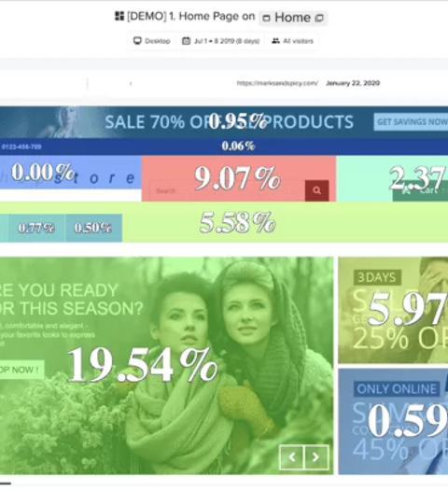
Contentsquare Zoning
Heatmapping + Journey Analytics
Industry-leading Content Analytics aimed at mid-market to enterprise customers focus on attribution, analytics and collecting ideal data before experimentation

Slide 36
Zoning Analysis – What is it
We can sell Zoning on our paper
Exclusive
This is a perfect fit
We have long-term integration roadmap
We have an agreement to sell Zoning on our paper at 40% markup to get reps commission and quota
We are the only ones in the world that can do this – even Contentsquare reps cant do this directly
We don’t have User Analytics, our competitors have it (VWO)
This will facilitate the field to adopt quicker and sell easier
Resell (now)
Integrate better (H2 2023)
White label (2024)

Slide 37
Contentsquare – At a Glance
Digital Experience Analytics Cloud
Contentsquare Services
Partner Ecosystem
CS Digital
Optimizely will only be selling Zoning Analysis – a component of the CS Digital Suite
Zoning Analysis
Rationale – it’s the product that compliments Optimizely the easiest/best and drives the best initial value
CS Insights
CS Find & Fix
Contentsquare reps cannot sell this standalone
This will be an exclusive offer for Optimizely at an exclusive price point
Contentsquare can then prospect the upsell
CS Apps
CS Merchandise

Slide 38
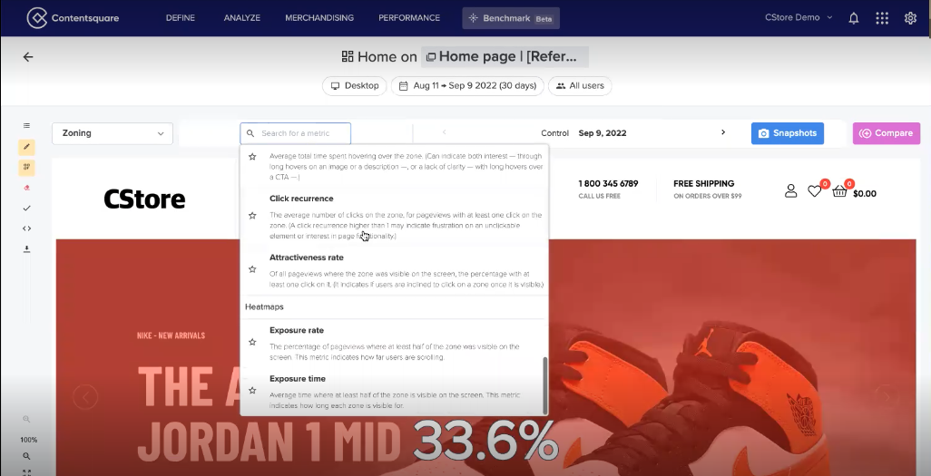
Contentsquare Zoning Analysis
Multiple metrics to evaluate page performance

Slide 39
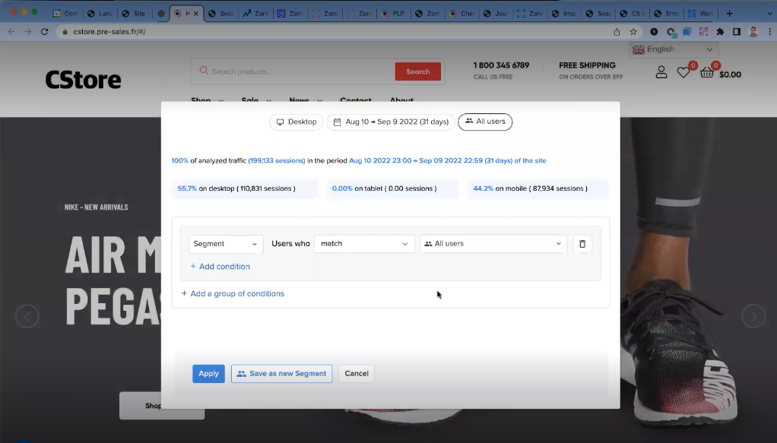
Contentsquare Zoning Analysis
Evaluate segments of users to asses page performance

Slide 40
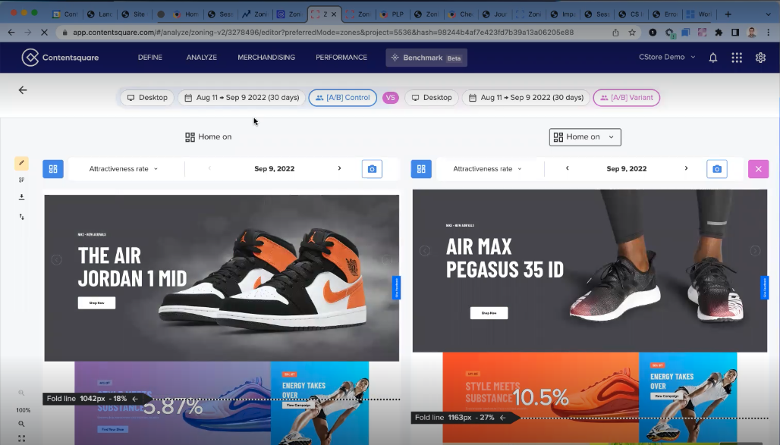
Contentsquare Zoning Analysis
Compare page variations fed by Optimizely

Slide 41
Zoning Analysis – Rate Card
Volume | Price
Up to 2M MAU | $25,000
3M | $30,000
4M | $35,000
5M | $40,000
7.5M | $52,500
10M | $62,000
15M | $81,000
We will have rate cards in local currency
We will not be creating rate cards for alternative metrics (Impressions, PV etc)
It should not be assumed that customer’s MAU volume for experimentation matches MAU count above as customer could use this tool on more or less sites than they do experimentation

Slide 42

Vercel Hosting
(Finalizing)
Hosting of Headless Applications
Industry-leading application hosting and development framework to support our SaaS CMS Option

Slide 43

Lucid Chart Seats
(in development)
Visualization Tooling to support CMP
Industry-leading visualization canvas supporting teams collaborating on Experimentation

Slide 44
Questions?

